Slide 1

TVS E.P.I.C. CREDIT (IT CHALLENGE)
Round 2
Code Linguists
Team Members:-Prithviraj Mutalik (Leader)
:-Harsh Agarwal

Slide 2
Contents
Introduction
Problem Statement
Video
Solution (Proposed work)
Objectives
Expected Frontend design(UI design)
Loan Approval Parameters
Model Building
Machine Learning
Classification and Prediction
Model Evaluation
Proposed Predictive Model
Result and Analysis with Methodology
Conclusion

Slide 3
Problem Description
We at EPIC Season 2 project (Round 2) are helping TVS Credit in Loan Approval. One major point of Loan Prediction is checking CIBIL Score to evaluate if a person should be given the loan or not.
The problem arises if a person doesn't have credit history. We need to overcome the problem of evaluating the credit worthiness of a potential retailer using non-standard data in the absence of credit history.

Slide 4

Explanatory Video

Slide 5
Solution
We propose to make a web application named "Credit Scorer" to overcome the problem statement.
We will be entering some numerical data (rating) into the website. The value of data will range from 0 to 5 in which 0 represents that the specified field is not satisfactory to the retailer and 5 represents that the specified field is according to the expectations of the finance company.
The Machine Learning algorithms will evaluate the inputs and will predict if a person should be given the required loan or not.

Slide 6
Objective
To evaluate and compare few ML and Ensemble methods for Classification.
To propose a Predictive Model/Classifier (Data Mining framework) based on Ensemble Method (Bagging) for classifying credit defaults.
To implement and evaluate the proposed Predictive Model (Data Mining) framework for Credit Worthiness Identification through demonstration.
To demonstrate and validate the efficacy of proposed (solution) by comparing with existing base classifiers.

Slide 7
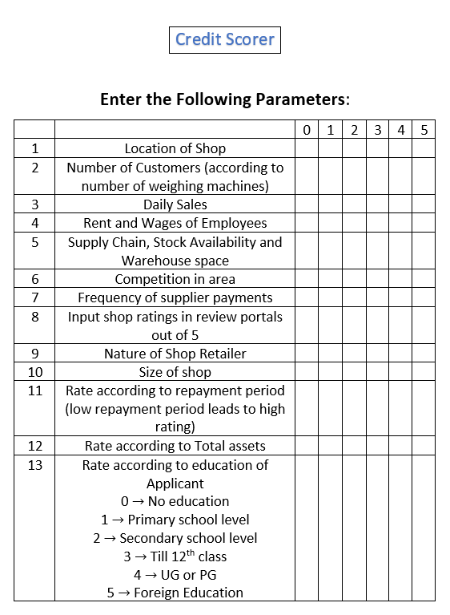
Expected frontend design

Slide 8
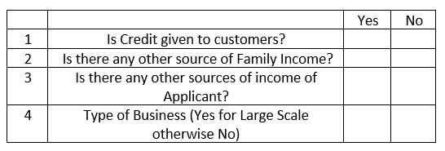
Expected frontend design

Slide 9
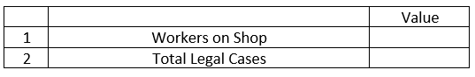
Expected frontend design

Slide 10
Loan approval parameters
Location of Shop:- If a shop is located at a good locality, then there are high chances of repayment. If it is located in a bad locality, then there are low chances of repayment.
Number of customers visiting the shop (approximate):- The number of customers visiting are directly proportional to the number of weighing machines available, it reduces the waiting time of customers. So, the number of weighing machines are important for this parameter.
Daily Sales:- If the daily sales are declared to be high, there are high chances of repayment. Otherwise, the chances of repayment are low. Not declaring the daily sales will lead to zero rating.
Workers on shop:- The number of workers on shop is directly proportional to the chances of repayment of loan.

Slide 11
LOAN APPROVAL PARAMETERS
Rent and Wages of employees:- The employee satisfaction depends on the wages given to them. More the wages given to them, more the chances of repayment of loan and the rating will be more.
Amount of credit to customers:- More the amount of credit given to customers, more is the probability of repayment of the loan.
Supply chain, stock availability and warehouse space:- The more these services available to the retailer, the greater is the points.
Competition in area:- If there is a tough competition, then chances of low rating (0-2) is high.

Slide 12
LOAN APPROVAL PARAMETERS
Frequency of supplier payments:- Higher the frequency of supply payments, higher will be the profit in the business.
Shop ratings in review portals:- Higher the shop rating in review portals, higher will be the probability of repayment of loan.
Nature of shop retailer (as given by reviewer):- Depending on the overall reviews of the shop retailer, a good review leads to a high rating and so there is high probability of fast repayment of loan.
Size of shop:- If the size of shop is large, then it will indicate to some wealth in the form of land, leading to higher points.

Slide 13
LOAN APPROVAL PARAMETERS
Repayment period:- If the total tenure of the loan is less, he/she is willing to repay the loan in smaller duration of time.
Other sources of family income:- If there are other sources of income for the family, the probability of repayment of loan is very high.
Total fixed assets:- If there are fixed assets like gold, car, home etc, there are more chances that the loan will be repaid faster, leading to higher points.
Education of applicant:- If the applicant has higher education, he/she may survive in business in a better way, which will increase the rating overall.

Slide 14
LOAN APPROVAL PARAMETERS
Other sources of income (of applicant):- If the applicant has other sources of income, the chances of repayment of loan are quite high.
Type of Business:- If he/she has a big business then rating will be high. Example if a person sells wood for burning in crimination, and a person uses wood to make furniture, then higher rating will be given to person selling furniture.
Total legal cases on him/her (if any):- If there are Legal Cases on the retailer,(Chances of Defaulter is high) it leads to low rating. Otherwise, if there are no Legal Cases on him/her, it leads to high rating and the chances of repayment of loan get higher.

Slide 15
Machine Learning
Machine learning is a science that aims to build systems that can automatically learn from data. By learning in this concrete field we are talking about machines that have the ability to modify their behavior (as a response to external inputs) in a way that they can improve their performance.
Machine learning approaches have been extendedly used in many applications such as Classification of entities, web search, spam detection, recommender systems, medical diagnosis, speech recognition and many other applications.

Slide 16
CLASSIFICATION AND PREDICTION
Classification: Classification models predict categorical class labels
Examples:
A bank loan officer wants to analyze the data in order to know which customer (loan applicant) are risky or which are safe.
A marketing manager at a company needs to analyze a customer with a given profile, who will buy a new computer.
Prediction:
Prediction models predict continuous valued functions.
Examples:
Suppose the marketing manager needs to predict how much a given customer will spend during a sale at his company. In this example we are bothered to predict a numeric value.
Therefore the data analysis task is an example of numeric prediction. In this case, a model or a predictor will be constructed that predicts a continuous-valued-function or ordered value.

Slide 17
Model Building
Model Building 1. Logistic Regression: - Logistic Regression is a classification algorithm to predict binary outcome from linear combination of predictor variables. Confusion matrix
2. Support Vector Machine: - Support Vector Machine (SVM) is a supervised machine learning algorithm which can be used for both classification or regression challenges.
XGBoost : - XGBoost is a decision-tree-based ensemble Machine Learning algorithm that uses a gradient boosting framework.

Slide 18
MODEL BUILDING
Decision Tree: It is the predictive modelling based on branching series of Boolean test. It create tree like graph where each node represent attribute and each leaf represents class label. It gives different rules
Random Forest: - It builds n number of trees to help making model accurate (different observation for same data for different trees). It is based on feeding error of one data tree to another to improve accuracy
K Nearest Neighbour: - It predict test case on nearest neighbour. It stores all available cases and classifies new cases based on similarity measure. It is considered to be lazy learning. It never stores pattern from training data. It calculates the distance between test cases and training cases and select the least distance.

Slide 19
MODEL EVALUATION
Model evaluation aims to estimate the generalization accuracy of a model on future (unseen/out-of-sample) data. To evaluate confusion matrix is used. It is a matrix representation of the results of any binary testing. A binary classifier predicts all data instances of a test data set as either positive or negative. This produces four outcomes: TP, FP, TN, FN. Basic measures derived from the confusion matrix:
1. Error Rate: (𝐹𝑃+𝐹𝑁) / (𝑃+𝑁)
2. Accuracy: (𝐹𝑃+𝑇) / (𝑃+𝑁)
3. Recall: 𝑇𝑃 / (𝑇𝑃+𝐹𝑁)
4. Precision: 𝑇𝑃 / (𝑇𝑃+𝐹𝑃)
5. F-Score: 𝑇𝑃 / (𝑇𝑃+0.5(𝐹𝑃+𝐹𝑁))

Slide 20
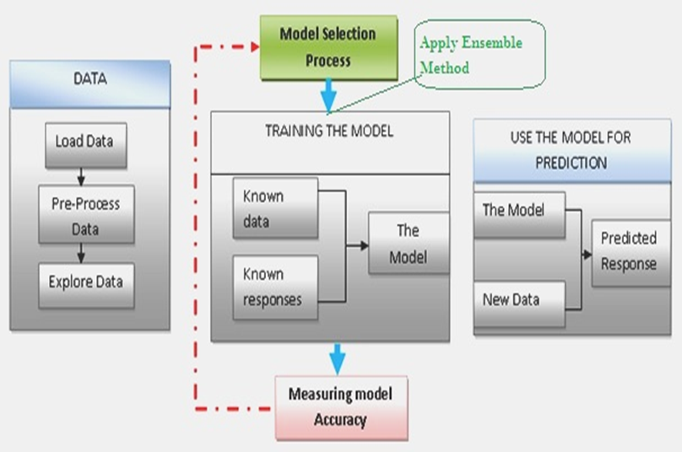
Proposed Predictive Model

Slide 21
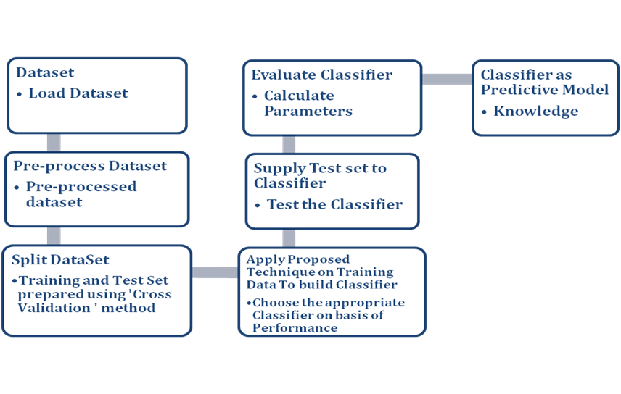
Result and Analysis with methodology

Slide 22
Conclusion
Hence by using all the above proposed work, we can build a model which can be easily used by the company.

Slide 23



